Slide 1

PROJECT OVERVIEW
EASY
ADVANCED

Slide 2

TELECOM CUSTOMERS CHURN PREDICTION
In this hands-on project, we will train several classification algorithms namely Logistic Regression, Support Vector Machine, K-Nearest Neighbors, and Random Forest Classifier to predict the churn rate of Telecommunication Customers.
Telecom service providers use customer attrition analysis as one of their key business metrics because the cost of retaining an existing customer is far less than acquiring a new one.
Machine Learning algorithms help companies analyze customer attrition rate based on several factors which includes various services subscribed by the customers, tenure rate, gender, senior citizen, payment method, etc.
Image Source: https://pixabay.com/illustrations/family-customer-target-group-ball-563968/
Dataset Source : https://www.kaggle.com/blastchar/telco-customer-churn

Slide 3
CODE DEMO
EASY
ADVANCED

Slide 4
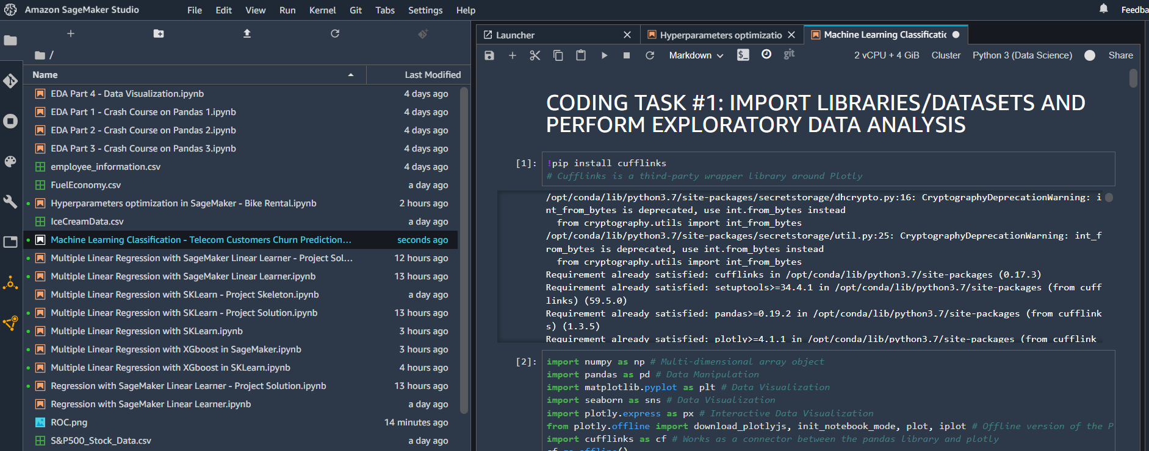
CODE DEMO

Slide 5
LOGISTIC REGRESSION CLASSIFIER MODEL
EASY
ADVANCED

Slide 6

LOGISTIC REGRESSION: INTUITION
Linear Regression is used to predict outputs on a continuous spectrum.
Example: Predicting revenue based on the outside air temperature.
Logistic Regression is used to predict binary outputs with 2 possible values (0 or 1).
Example: Logistic model output can be one of two classes: pass/fail, win/lose, healthy/sick
Hours Studying | Pass/Fail
1 | 0
1.5 | 0
2 | 0
3 | 1
3.25 | 0
4 | 1
5 | 1
LINEAR MODEL
PASS/FAIL
HOURS OF STUDYING

Slide 7
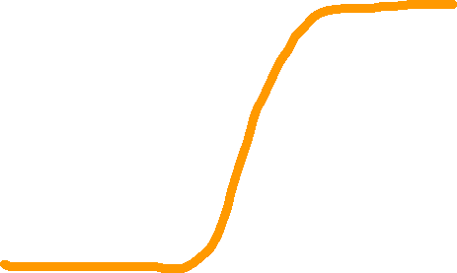
LOGISTIC REGRESSION: MATH
Linear Regression is not suitable for classification problem.
Linear Regression is unbounded, so Logistic Regression will be a better candidate in which the output value ranges from 0 to 1.
Linear Equation:
y= b_{o} + b₁ * x
Apply Sigmoid Function:
P(x)= sigmoid(y)
P(x)= 1/1+e^{-y}
P(x)= 1/1+e^{-(b0 + b}1 ^{* x)}
LINEAR MODEL
PASS/FAIL
LOGESTIC REGRESSION MODEL
HOURS OF STUDYING

Slide 8

LOGISTIC REGRESSION: FROM PROBABILITY TO CLASS
Now we need to convert from a probability to a class value which is “0” or “1”
Linear Equation:
y= b_{o} + b₁ * x
Apply Sigmoid Function:
P(x)= sigmoid(y)
P(x)= 1/1+e^{-y}
P(x)= 1/1+e^{-(b0 + b}1 ^{* x)}
LOGESTIC REGRESSION MODEL
CLASS 1
PASS/FAIL
0.5
CLASS 0
THRESHOLD
HOURS OF STUDYING

Slide 9
SUPPORT VECTOR MACHINES (SVM)
EASY
ADVANCED

Slide 10
SUPPORT VECTOR MACHINES: INTUITION
Assume that you are data scientist working at a major bank in NYC.
You want to classify a new client as eligible to retire or not, customer features are: Age and Savings.
SUPPORT VECTORS
FEATURE #2: SAVINGS
MAXIMUM MARGIN
MAX MARGIN
HYPERPLANE
FEATURE #1: AGE

Slide 11



SUPPORT VECTOR MACHINES: INTUITION
FEATURE #2
FEATURE #1

Slide 12
SUPPORT VECTOR MACHINES: MODEL EVALUATION
TRAINED MODEL
(MAX MARGIN
HYPERPLANE)
FEATURE #2
TESTING DATASET
FEATURE #1

Slide 13
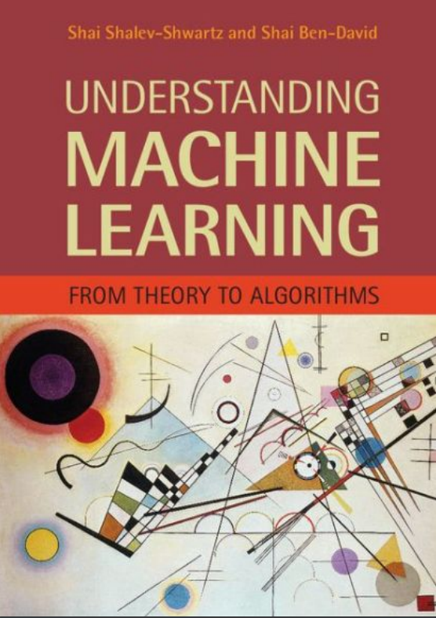
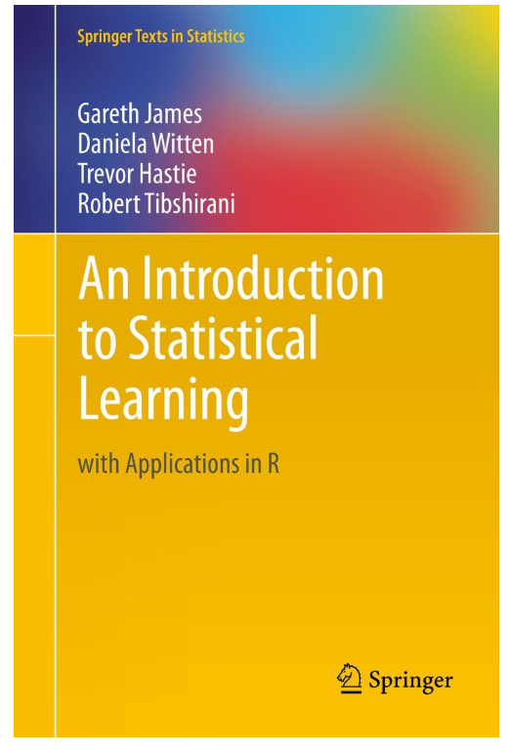
SUPPORT VECTOR MACHINES: ADDITIONAL READING MATERIAL
Additional Resources, Page #202: http://www.cs.huji.ac.il/~shais/UnderstandingMachineLearning/understanding-machine-learning-theory-algorithms.pdf
Additional Resources, Page #337:
http://www-bcf.usc.edu/~gareth/ISL/ISLR%20Seventh%20Printing.pdf

Slide 14
RANDOM FOREST CLASSIFIER MODELS
EASY
ADVANCED

Slide 15
RANDOM FOREST CLASSIFIER: INTUITION
Random Forest classifier is a type of ensemble algorithm
It creates a set of decision trees from randomly selected subset of training set
It then combines votes from different decision trees to decide the final class of the test object.
TREE #1
TREE #2
TREE #N
Savings>$1M
Savings>$1M
Savings>$1M
Y
N
Y
N
Y
N
Age>45?
Class #0
Age>45?
Class #0
Age>45?
Class #0
Y
N
Y
N
Y
N
Class #1
Class #0
Class #1
Class #0
Class #1
Class #0
OUT= CLASS #1
OUT= CLASS #1
OUT= CLASS #0
MAJORITY VOTE= CLASS #1

Slide 16
RANDOM FOREST: WHY AND HOW?
Complete Training set
It overcomes the issues with single decision trees by reducing the effect of noise
Overcomes overfitting problem by taking average of all the predictions, canceling out biases
Suppose training set: [X1, X2, X3, X4] with labels: [L1, L2, L3, L4]
Random Forest creates three decision trees taking inputs as follows: [X1, X2, X3], [X1, X2, X4], [X2, X3, X4]
Example: Combining votes from a pool of expert, each will bring their own experience and background to solve the problem resulting in a better outcome.
Runs effectively on large database
For large data, it produces highly accurate predictions
Training set #1
Training set #2
Training set #3
Decision Tree #2
Decision Tree #1
Decision Tree #3
VOTING

Slide 17
K-NEAREST NEIGHBOUR (KNN)
EASY
ADVANCED

Slide 18


K NEAREST NEIGHBORS (KNN): INTUITION
K-Nearest Neighbors (KNN) algorithm is a classification algorithm
KNN works by finding the most similar data points in the training data, and attempt to make an educated guess based on their classifications
SIZE: SMALL
SIZE: LARGE
L
S
150 160 170 180
HEIGHT (CMS)
?
55 60 65 70 75
WEIGHT (KGS)

Slide 19
Select a value for k (e.g.: 1, 2, 3, …..)
Calculate the Euclidian distance between the point to be classified and every other point in the training data set
Pick the k closest data points (points with the k smallest distances)
Run a majority vote among selected data points, the dominating classification is the winner. Point is classified based on the dominant class
Repeat
K NEARSET NEIGHBORS (KNN): ALGORITHM STEP

Slide 20
EUCILIDEAN DISTANCE: INTUITION
Euclidean Distance= √(x₂-x₁)² + (y₂-y₁)²
y₂
Point B (x_{2,} y₂)
y₁
Point A (x_{1,} y₁)
x₁
x₂

Slide 21
K NEARSET NEIGHBORS (KNN): EXAMPLE
KNN will look for the 5 data points that are closest to the new customer data point
The algorithm will determine which category (class) are these 5 points in
Since 4 points had class “SMALL” and 1 had “LARGE”, then new customer shall be assigned small size
New Customer Information:
Height: 161
Weight: 61
Assume, k= 5
Height | Weight | T-Shirt Size | Euclidian Dist | Vote
158 | 58 | S | 4.242640687
158 | 59 | S | 3.605551275
158 | 63 | S | 3.605551275
160 | 59 | S | 2.236067977 | 3
160 | 60 | S | 1.414213562 | 1
163 | 60 | S | 2.236067977 | 3
163 | 61 | S | 2 | 2
160 | 64 | L | 3.16227766 | 5
163 | 64 | L | 4
165 | 61 | L | 4.123105626
165 | 62 | L | 5.656858249
Example Source: https://www.listendata.com/2017/12/k-nearest-neighbor-step-by-step-tutorial.html

Slide 22
NAÏVE BAYES CLASSIFIER MODEL
EASY
ADVANCED

Slide 23
NAÏVE BAYES: INTUITION
Naïve Bayes is a classification technique based on Bayes’ Theorem.
Let’s assume that you are data scientist working major bank in NYC and you want to classify a new client as eligible to retire or not.
Customer features are his/her age and salary.
CLASS 1: RETIRE
40 BLUE POINTS
NEW CUSTOMER
FEATURE #2: SAVINGS
?
CLASS 0: NO RETIRE
20 RED POINTS
FEATURE #1: AGE

Slide 24


NAÏVE BAYES: 1. PRIOR PROBABILITY
CLASS 1: RETIRE
Points can be classified as RED or BLUE.
Our task is to classify a new point to RED or BLUE.
Prior Probability: Since we have more BLUE compared to RED, we can assume that our new point is twice as likely to be BLUE than RED.
40 BLUE POINTS
FEATURE #2: SAVINGS
$$Prior Probability for RED=\frac{Number of RED Points}{Total Number of Points}=\frac{20}{60}$$
?
CLASS 0: NO RETIRE
$$Prior Probability for BLUE=\frac{Number of BLUE Points}{Total Number of Points}=\frac{40}{60}$$
20 RED POINTS
FEATURE #1: AGE

Slide 25


NAÏVE BAYES: 2. LIKELIHOOD
For the new point, if there are more BLUE points in its vicinity, it is more likely that the new point will be classified as BLUE.
So we draw a circle around the point
Then we calculate the number of points in the circle belonging to each class label.
40 BLUE POINTS
FEATURE #2: SAVINGS
$$Likelihood of X being RED=\frac{Number of RED Points in vicinity }{Total Number of RED Points}=\frac{3}{20}$$
?
$$Likelihood of X being BLUE=\frac{Number of BLUE Points in vicinity }{Total Number of BLUE Points}=\frac{1}{40}$$
20 RED POINTS
FEATURE #1: AGE

Slide 26
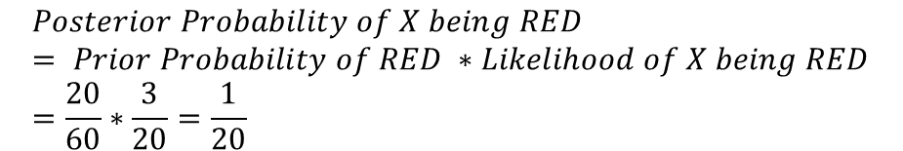
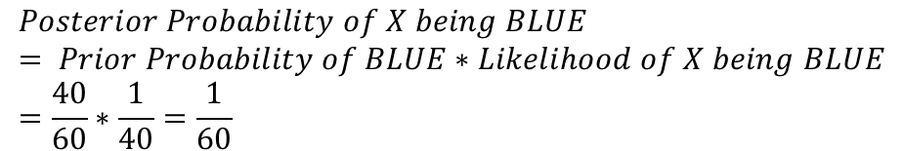
NAÏVE BAYES: 3. POSTERIOR PROBABILITY
40 BLUE POINTS
Let’s combine prior probability and likelihood to create a posterior probability.
Prior probabilities: suggests that X may be classified as BLUE Because there are twice as much blue points.
Likelihood: suggests that X is RED because there are more RED points in the vicinity of X.
Bayes’ Rule combines both to form a posterior probability.
FEATURE #2: SAVINGS
?
$$Posterior Probability of X being RED= Prior Probability of RED ∗Likelihood of X being RED=\frac{20}{60}∗\frac{3}{20}=\frac{1}{20}$$
20 RED POINTS
FEATURE #1: AGE
X CLASSIFIED AS RED (NON RETIRING) SINCE IT HAS LARGER POSTERIOR PROBABILITY
$$Posterior Probability of X being BLUE= Prior Probability of BLUE∗Likelihood of X being BLUE=\frac{40}{60}∗\frac{1}{40}=\frac{1}{60}$$

Slide 27
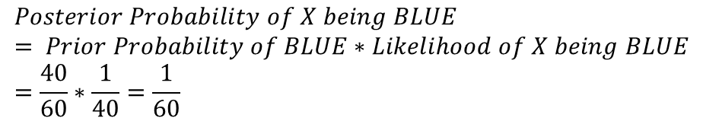
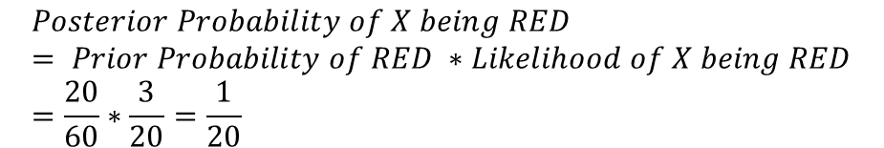
NAÏVE BAYES: REVIEW
40 BLUE POINTS
Let’s combine prior probability and likelihood to create a posterior probability.
Prior probabilities: suggests that X may be classified as BLUE Because there are twice as much blue points.
Likelihood: suggests that X is RED because there are more RED points in the vicinity of X.
Bayes’ Rule combines both to form a posterior probability.
FEATURE #2: SAVINGS
?
$$Posterior Probability of X being RED= Prior Probability of RED ∗Likelihood of X being RED=\frac{20}{60}∗\frac{3}{20}=\frac{1}{20}$$
20 RED POINTS
FEATURE #1: AGE
$$Posterior Probability of X being BLUE= Prior Probability of BLUE∗Likelihood of X being BLUE=\frac{40}{60}∗\frac{1}{40}=\frac{1}{60}$$
X CLASSIFIED AS RED (NON RETIRING) SINCE IT HAS LARGER POSTERIOR PROBABILITY

Slide 28

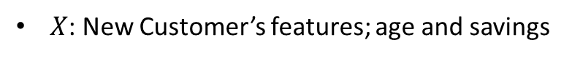
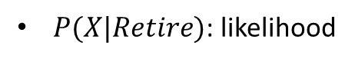



NAÏVE BAYES: SOME MATH!
Naïve Bayes is a classification technique based on Bayes’ Theorem.
PRIOR PROBABILITY OF RETIRING
LIKELIHOOD
$$P\left(Retire\right|X)=\frac{P\left(X | Retire\right)∗P(Retire)}{P(X) }$$
MARGINAL LIKELIHOOD
$X$: New Customer’s features; age and savings
$P\left(Retire\right|X)$: probability of customer retiring given his/her features, such as age and savings
$P(Retire)$: Prior probability of retiring, without any prior knowledge
$P(X|Retire)$: likelihood
$P(X)$: Marginal likelihood, the probability of any point added lies into the circle

Slide 29
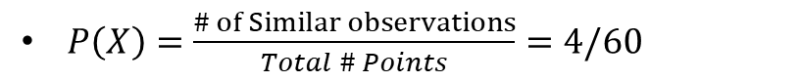


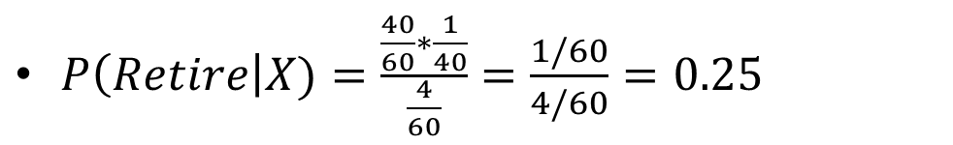

NAÏVE BAYES: SOME MATH!
PRIOR PROBABILITY OF RETIRING
LIKELIHOOD
CLASS 1: RETIRE
40 BLUE POINTS
$$P\left(Retire\right|X)=\frac{P\left(X | Retire\right)∗P(Retire)}{P(X) }$$
MARGINAL LIKELIHOOD
FEATURE #2: SAVINGS
$P\left(Retire\right)=\frac{\# of Retiring}{Total points}= 40/60$
?
$P\left(X | Retire\right)=\frac{\# of smilar observations for retiring}{Total \# retiring}=1/40$
CLASS 0: NO RETIRE
$P\left(X\right)=\frac{\# of Similar observations}{Total \# Points}=4/60$
20 RED POINTS
$P\left(Retire\right|X)=\frac{\frac{40}{60}∗\frac{1}{40}}{\frac{4}{60}}=\frac{1/60}{4/60}=0.25$
FEATURE #1: AGE

Slide 30
NAÏVE BAYES: WHY NAÏVE?
CLASS 1: RETIRE
It is called naive because it assumes that the presence of a certain feature in a class is independent of the presence of other features.
EXAMPLE #1: Age/savings, the assumption is not necessarily true since age and savings might be dependant on each others
EXAMPLE #2: fruit can be classified as watermelon if its color is green, tastes sweet, and round.
These features might be dependant on each others, however, we assume they are all independent and that’s why its ‘Naive’!
40 BLUE POINTS
FEATURE #2: SAVINGS
?
CLASS 0: NO RETIRE
20 RED POINTS
FEATURE #1: AGE

Slide 31
PRACTICE OPPORTUNITY 5
EASY
ADVANCED

Slide 32
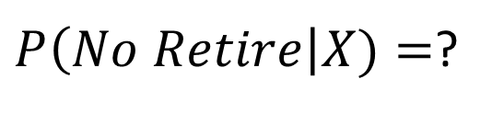
NAÏVE BAYES: QUIZ/CALCULATE THE PROBABILTY OT NON-RETIRING (RED CLASS)
$P\left(No Retire\right|X)=$?

Slide 33
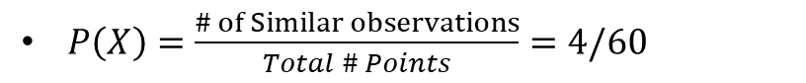


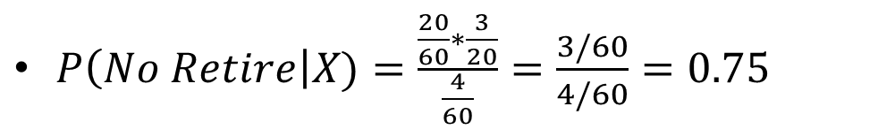


NAÏVE BAYES: QUIZ/CALCULATE THE PROBABILTY OT NON-RETIRING (RED CLASS)
PRIOR PROBABILITY OF NO RETIRING
CLASS 1: RETIRE
LIKELIHOOD
40 BLUE POINTS
$$P\left(No Retire\right|X)=\frac{P\left(X | No Retire\right)∗P(No Retire)}{P(X) }$$
MARGINAL LIKELIHOOD
$P\left(No Retire\right)=\frac{\# of No Retiring}{Total points}=20/60$
FEATURE #2: SAVINGS
$P\left(X | No Retire\right)=\frac{\# of smilar observations for No retiring}{Total \# no retiring}=3/20$
?
$P\left(X\right)=\frac{\# of Similar observations}{Total \# Points}=4/60$
CLASS 0: NO RETIRE
$P\left(No Retire\right|X)=\frac{\frac{20}{60}∗\frac{3}{20}}{\frac{4}{60}}=\frac{3/60}{4/60}=0.75$
20 RED POINTS
FEATURE #1: AGE
$$NOTE: P\left(Non Retire\right|X)=1−0.25=0.75$$

Slide 34
CLASSIFICATION MODELS KPIs RECAP [SKIP IF FAMILIAR]
EASY
ADVANCED

Slide 35
TRUE CLASS
CLASSIFICATION MODEL KPIs
+
-
Classiﬁcation Accuracy = (TP+TN) / (TP + TN + FP + FN)
Misclassiﬁcation rate (Error Rate) = (FP + FN) / (TP + TN + FP + FN)
Precision = TP/Total TRUE Predictions = TP/ (TP+FP) (When model predicted TRUE class, how often was it right?)
Recall = TP/ Actual TRUE = TP/ (TP+FN) (when the class was actually TRUE, how often did the classiﬁer get it right?)
+
TRUE +
FALSE +
PREDICTIONS
FALSE -
TRUE -
-

Slide 36
PRECISION Vs. RECALL EXAMPLE
FACTS:
100 PATIENTS TOTAL
91 PATIENTS ARE HEALTHY
9 PATIENTS HAVE CANCER
TRUE CLASS
+
-
Accuracy is generally misleading and is not enough to assess the performance of a classifier.
Recall is an important KPI in situations where:
Dataset is highly unbalanced; cases when you have small cancer patients compared to healthy ones.
TP = 1
FP = 1
+
PREDICTIONS
-
FN = 8
TN = 90
Classiﬁcation Accuracy = (TP+TN) / (TP + TN + FP + FN) = 91%
Precision = TP/Total TRUE Predictions = TP/ (TP+FP) = ½=50%
Recall = TP/ Actual TRUE = TP/ (TP+FN) = 1/9 = 11%

Slide 37
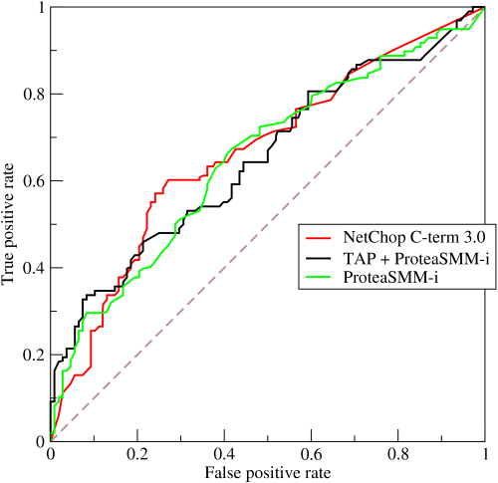
ROC (RECEIVER OPERATING CHARACTERISTIC CURVE)
ROC Curve is a metric that assesses the model ability to distinguish between binary (0 or 1) classes.
The ROC curve is created by plotting the true positive rate (TPR) against the false positive rate (FPR) at various threshold settings.
The true-positive rate is also known as sensitivity, recall or probability of detection in machine learning.
The false-positive rate is also known as the probability of false alarm and can be calculated as (1 − specificity).
Points above the diagonal line represent good classification (better than random)
The model performance improves if it becomes skewed towards the upper left corner.
Photo Credit: https://commons.wikimedia.org/wiki/File:Roccurves.png

Slide 38
AUC (AREA UNDER CURVE)
The light blue area represents the area Under the Curve of the Receiver Operating Characteristic (AUROC).
The diagonal dashed red line represents the ROC curve of a random predictor with AUROC of 0.5.
If ROC AUC = 1, perfect classifier
Predictor #1 is better than predictor #2
Higher the AUC, the better the model is at predicting 0s as 0s and 1s as 1s.
PREDICTOR #1
PREDICTOR #2
TRUE POSITIVE RATE
RANDOM PREDICTOR
FALSE POSITIVE RATE

